Slide 1

Bank Data Analytics
DONE BY:
Pranesh Kumaar V M
TOOLS USED:
Excel
Tableau
Power BI
MySQL

Slide 2
INTRODUCTION
Banks process huge volumes of loan applications every day.
Monitoring repayment, defaults, and customer trends is essential for stable growth.
Data analytics helps convert raw data into meaningful insights for decision making.
PROBLEM STATEMENT
The bank’s data is large and scattered, making it hard to track key metrics.
Management needs clear insights on loan disbursement, repayment, and default risks.
Early identification of high-risk areas is required to improve recovery.

Slide 3
AIM: To analyse bank loan data and identify key financial and customer trends.
SCOPE: Evaluate loan disbursement, collections, defaults and repayment patterns.
TOOLS: Excel for quick KPIs, SQL for data extraction, Tableau & Power BI for interactive dashboards.
GOAL: Provide insights to improve loan recovery and decision making.

Slide 4
KEY PERFORMANCE INDICATORS
Total Loan Applications – 38.3 K
Total Funded Amount – ₹430.6 M
Total Collection – ₹815 M
Average Interest Rate – 12 %
Default Rate – 1 %
Good Loan Issued – 74.5 %
INSIGHTS
Collections exceed total funded amount, indicating strong recovery.
Default rate is very low across all states.
30–40 age group and Home Loan purpose show highest funded amount.

Slide 5
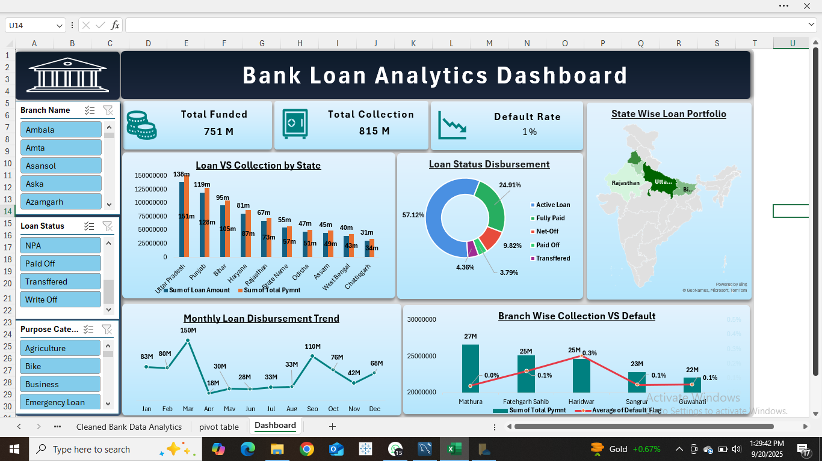
EXCEL DASHBOARD
HIGHLIGHTS
Total Funded: ₹751 M, Total Collection: ₹815 M, Default Rate: 1 %.
Uttar Pradesh shows the highest loan disbursement and collection.
57.12% of loans are Active, 25 % Fully Paid.
February recorded the peak monthly disbursement (₹150 M).
Mathura branch achieved highest collection with minimal default.

Slide 6
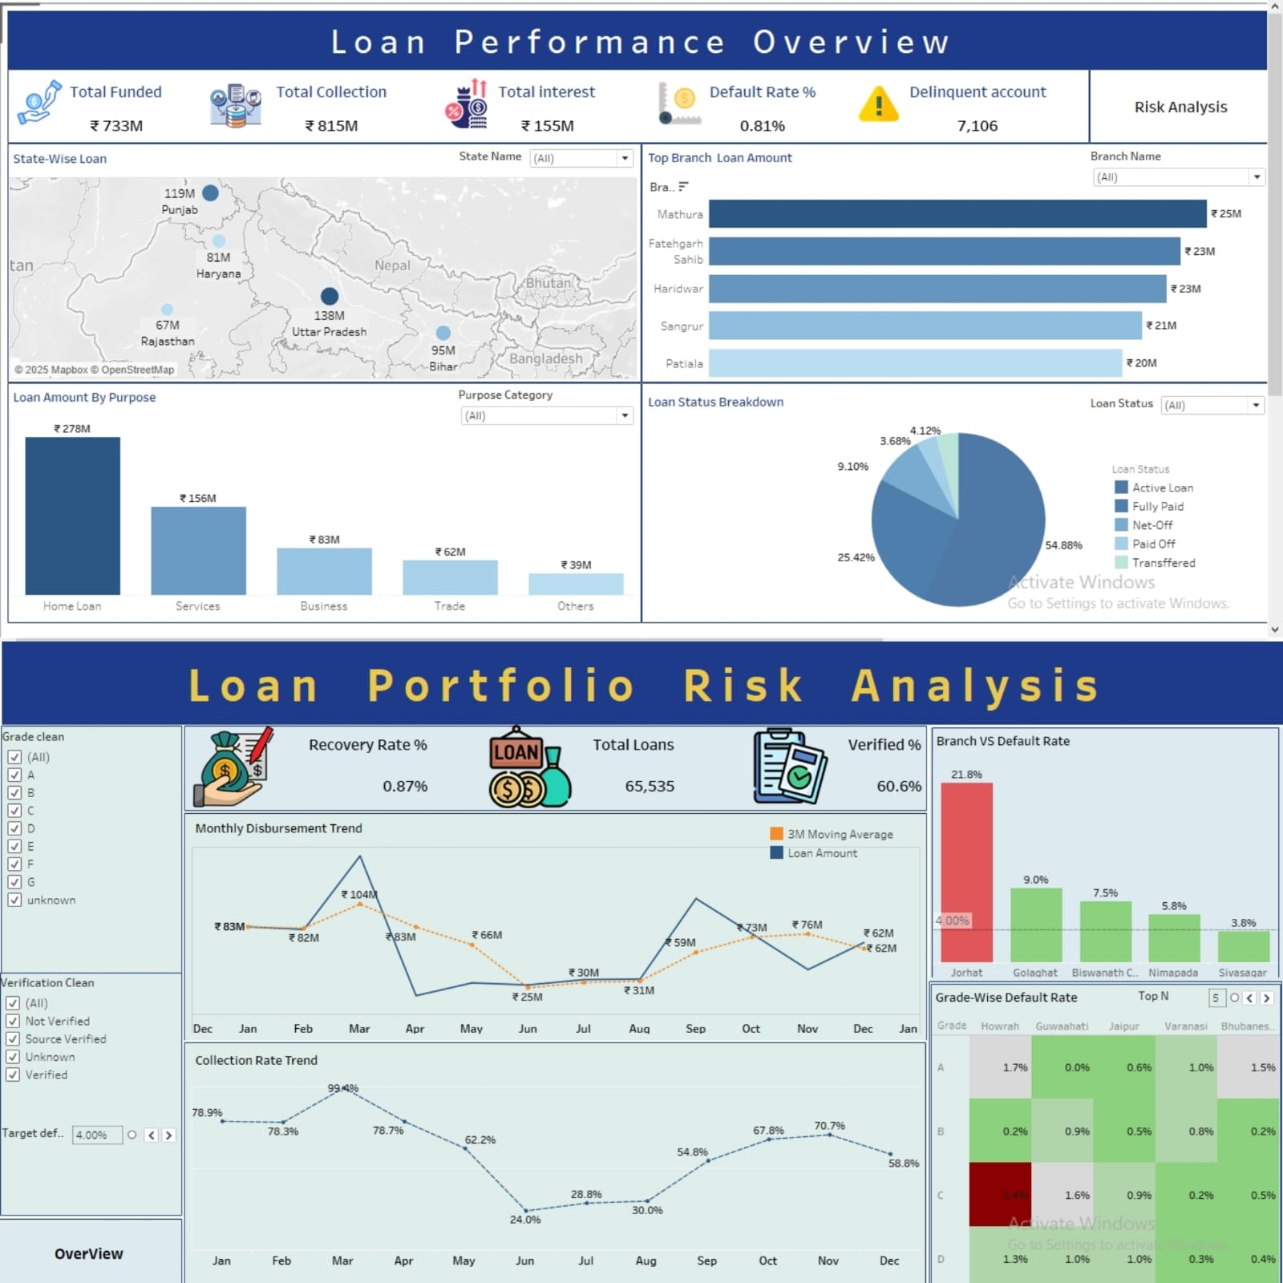
TABLEAU DASHBOARD
HIGHLIGHTS
Total Funded ₹733M | Collection ₹815M | Interest ₹155M
Default Rate only 0.81% but 7,106 delinquent accounts
Home Loan is top purpose – ₹278M
Recovery Rate very low – 0.87% | Verified Loans 60.6%
Highest Branch Default – 21.8% (Jorhat)

Slide 7
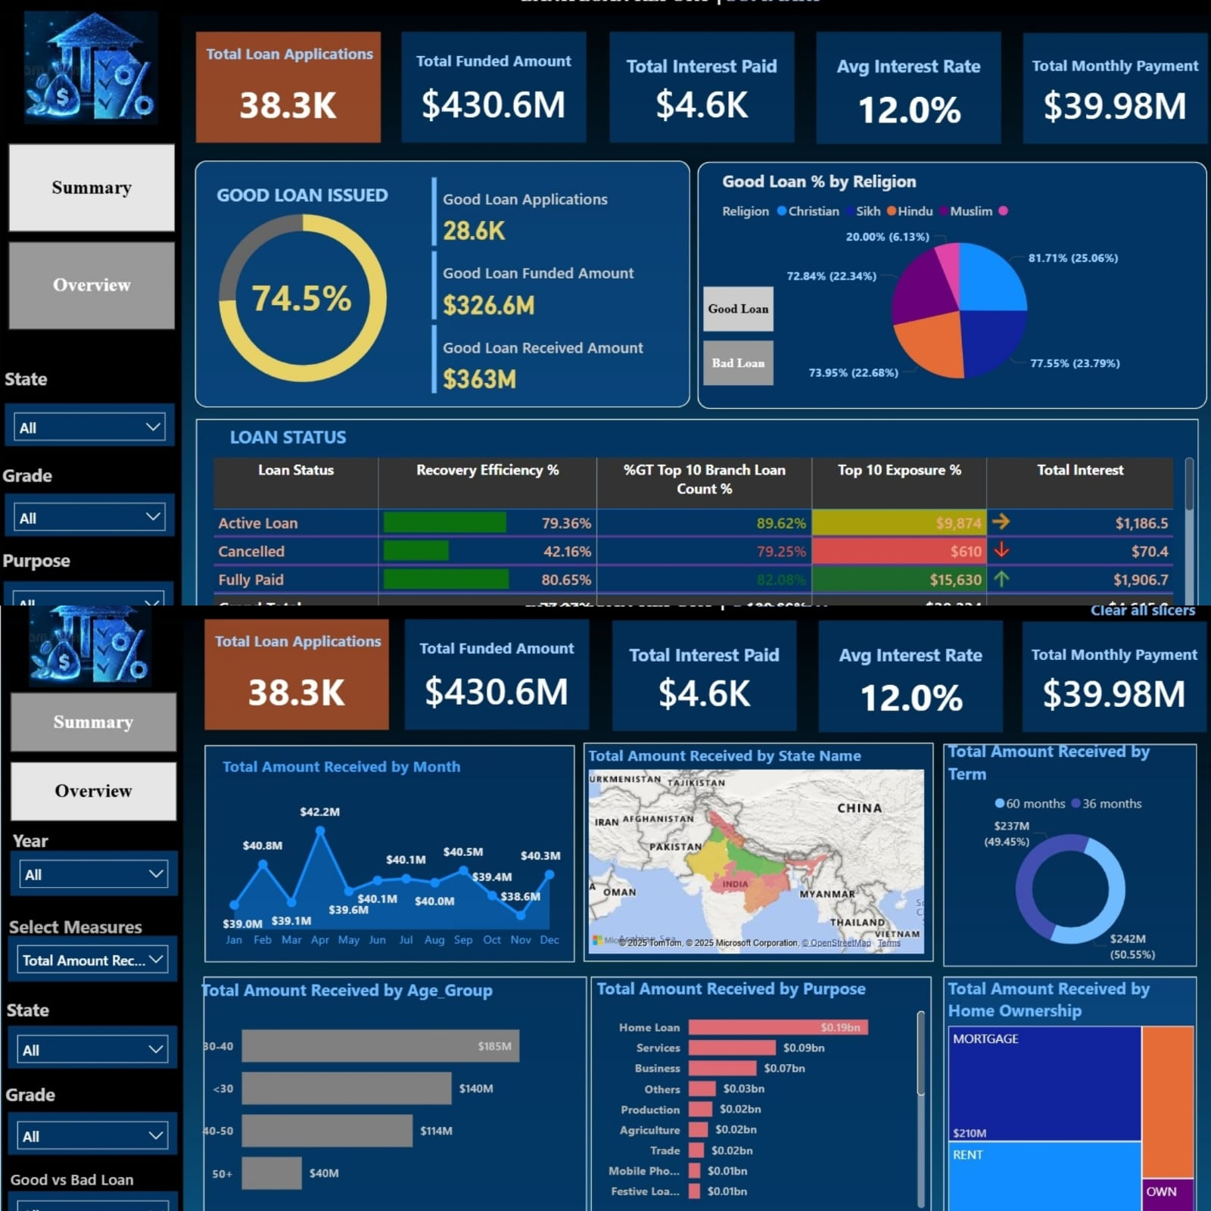
POWER BI DASHBOARD
HIGHLIGHTS
Good Loans Issued: 74.5% of applications.
Total Funded Amount: $430.6M
Loan Status Breakdown: Active (prominent in metrics).
Peak Disbursement Month: Insights in "Total Amount Received by Month" chart.
Mathura-like Highlight: No specific "Mathura" mention in given data; instead, "Top 10 Branch Loan Count" contributes significantly.

Slide 8
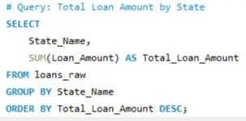
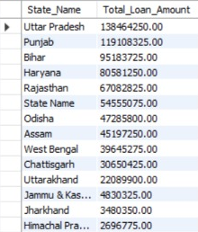
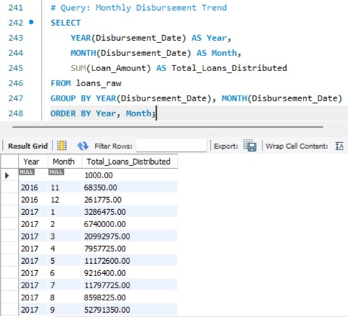
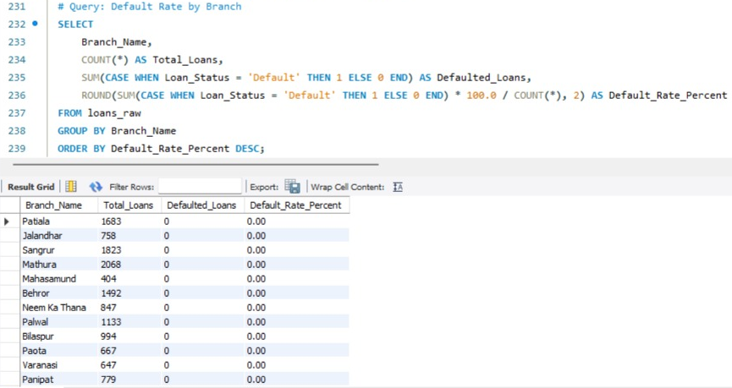
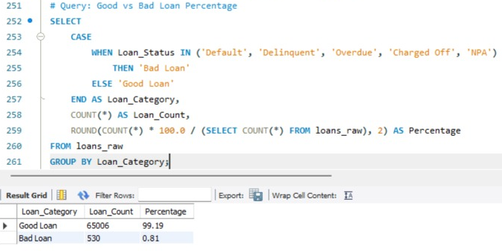
SQL QUERIES

Slide 9
SQL QUERIES
HIGHLIGHTS
Strong Portfolio Health: 99.19% of loans are Good, with only 0.81% being Bad.
Top Performing State: Uttar Pradesh has the highest total loan amount, leading the states.
Major Market: Punjab is a close second in total loan amount.
Significant Growth: Loan disbursements increased significantly from 2016 to 2017.
Bad Loan Categories: Bad loans are defined as Default, Delinquent, Overdue, Charged Off, or NPA.
Total Loan Count: The bank has a total of 65,536 loans.
Busiest Branch: The Patiala branch has the highest number of loans.
Zero Default Branches: Patiala, Sangrur, and Jalandhar branches have a 0% default rate.
Default Rate Calculation: The default rate is calculated by dividing the number of Default loans by the total loans per branch.
Disbursement Trend: The data tracks loan amounts disbursed each month to show growth trends.

Slide 10
OVERALL FINDINGS
Strong collection with very low default rate.
Northern states lead in both loan funding and repayment.
30–40 age group and Home Loan category dominate funding.
KEY LEARNINGS
Excel for KPI tracking and quick visuals.
SQL for data cleaning and extraction.
Tableau & Power BI for advanced, interactive reporting.
CONCLUSION
The analysis shows strong collections and very low defaults.Northern states and Home Loans lead in funding and repayment.Using Excel, SQL, Tableau, and Power BI, we turned raw data into clear insights,helping the bank improve loan recovery and decision making.

Slide 11
THANK YOU

